Slide 1
Algorithms
Mushtari Sadia

Slide 2
Shortest Path Algorithms
Dijkstra, Bellman-Ford

Slide 3
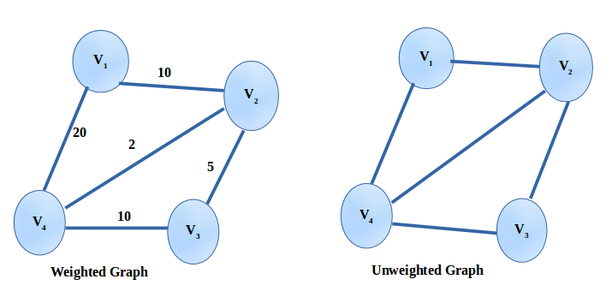
Weighted Graph

Slide 4
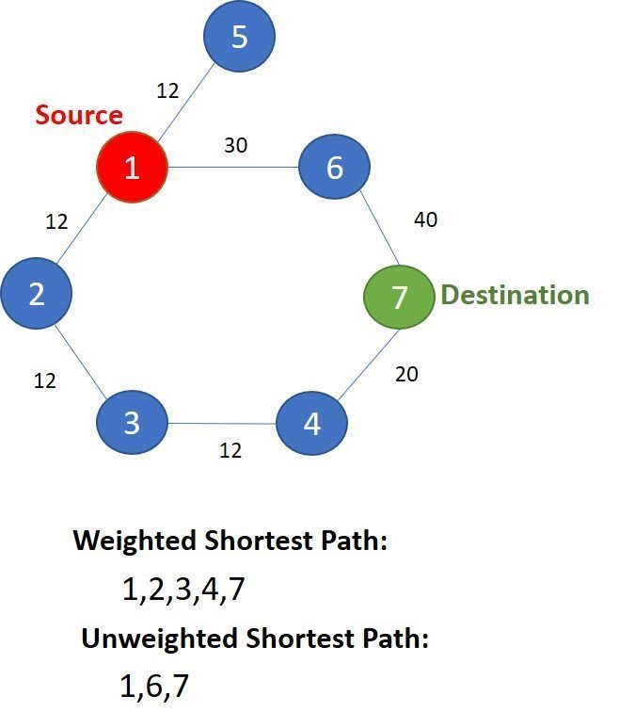
Weighted Graph and Shortest Path

Slide 5
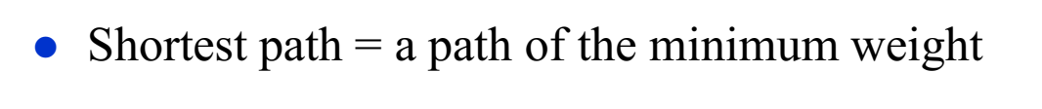
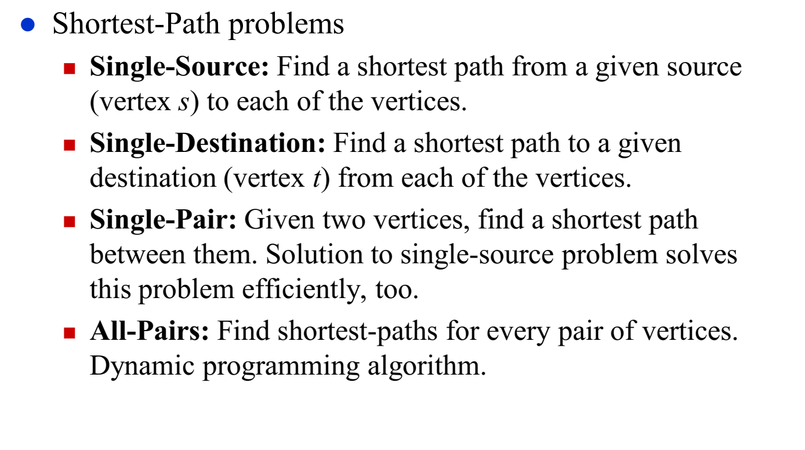
Shortest Path Problem

Slide 6
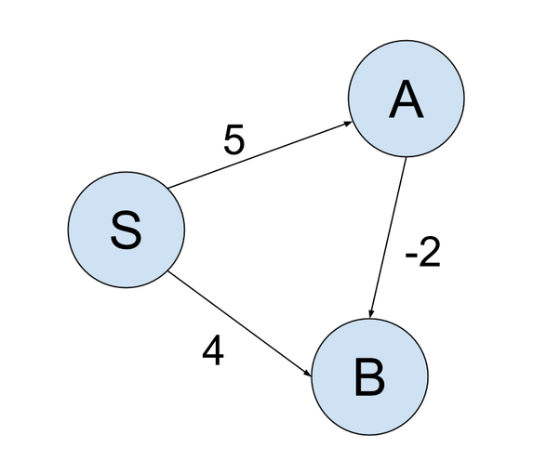
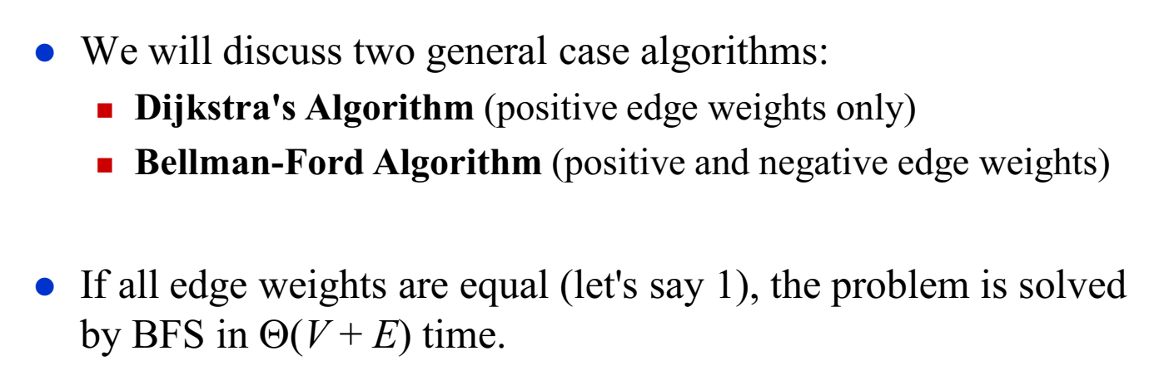
Single-Source Shortest Path Problem

Slide 7
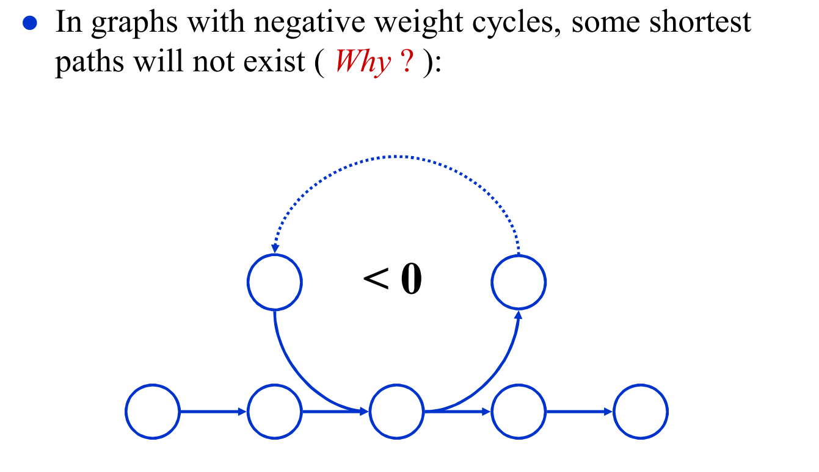
Shortest Path Properties

Slide 8
Negative Weight Cycle
Find the shortest path from S to T
S
T
1
3

Slide 9
Negative Weight Cycle
Find the shortest path from S to T
S
T
1
3
Distance = 1+3 =4

Slide 10
Negative Weight Cycle
Suppose the graph has more vertices like these
3
-6
2
S
T
1
3

Slide 11
Negative Weight Cycle
path | distance
1 | 4
Suppose the graph has more vertices like these
3
-6
2
S
T
1
1
3
Distance = 1+3 =4

Slide 12
Negative Weight Cycle
path | distance
1 | 4
2 | 3
Suppose the graph has more vertices like these
3
-6
2
S
T
1
1
3
Distance = 1-6+3+2+3 = 3

Slide 13
Negative Weight Cycle
path | distance
1 | 4
2 | 3
3 | 2
Suppose the graph has more vertices like these
3
-6
2
S
T
1
1
3
Will keep going reducing the distance, therefore shortest path cannot be found
Distance = 1-6+3+2-6+3+2+3 = 2

Slide 14
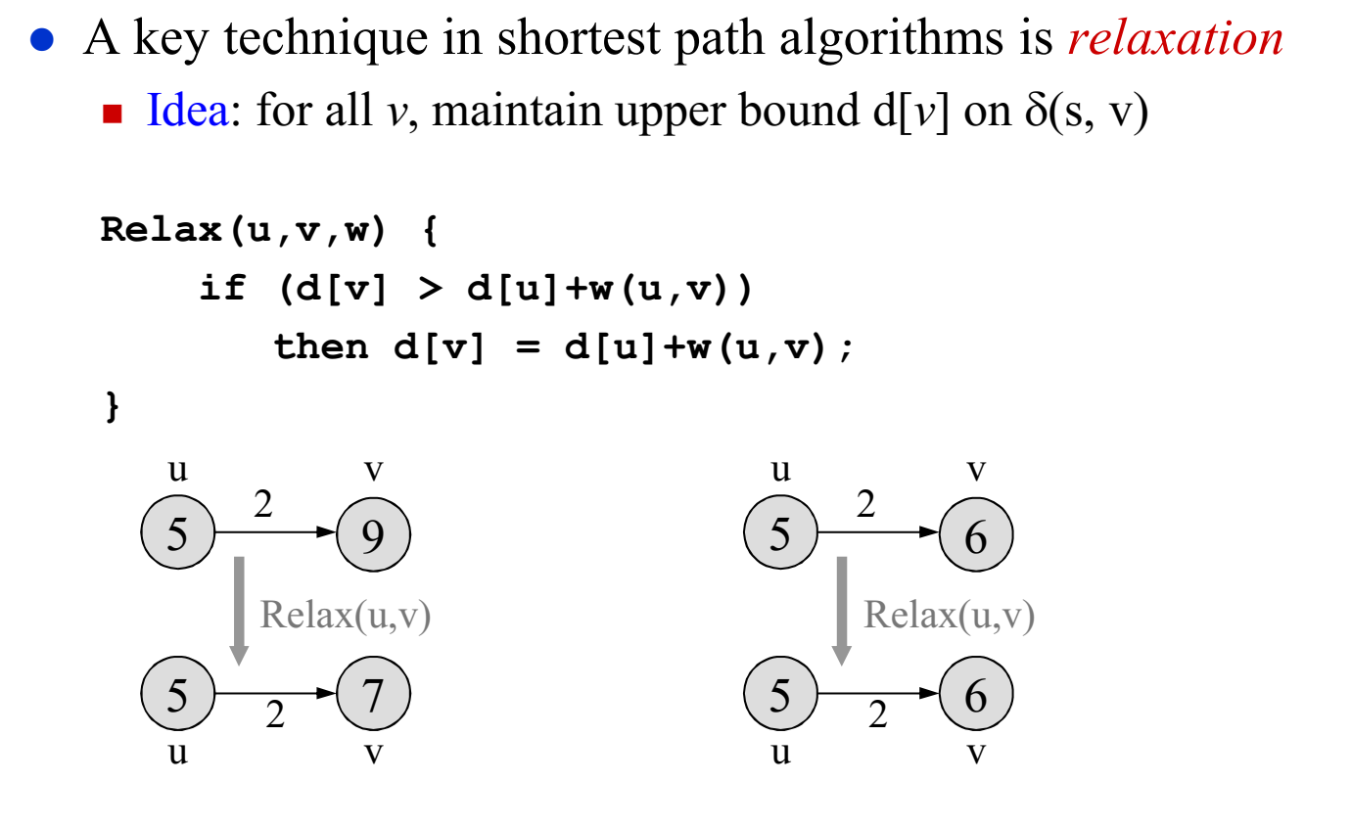
Relaxation
<Distance from source>
5+2 = 7 > 6
So, do not update
5+2 = 7 < 9
Update distance
of v to 7 from 9

Slide 15
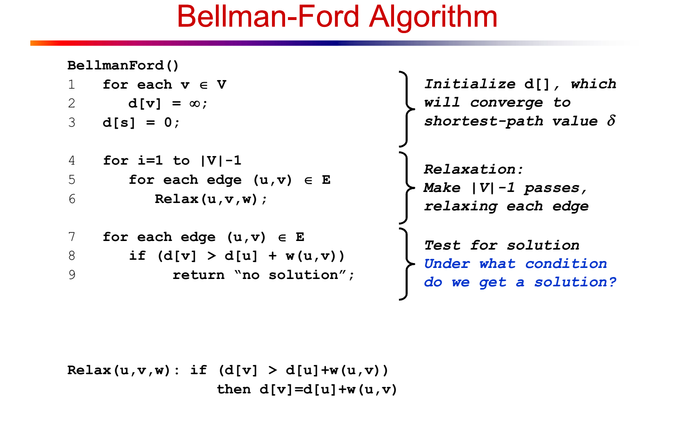
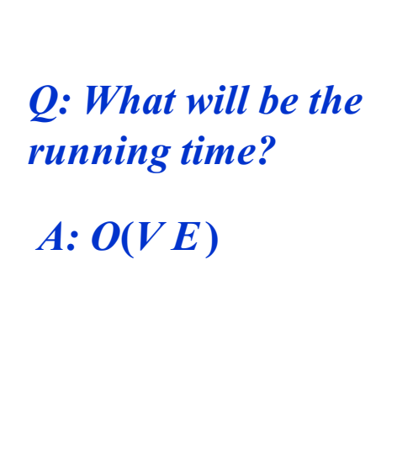

Slide 16
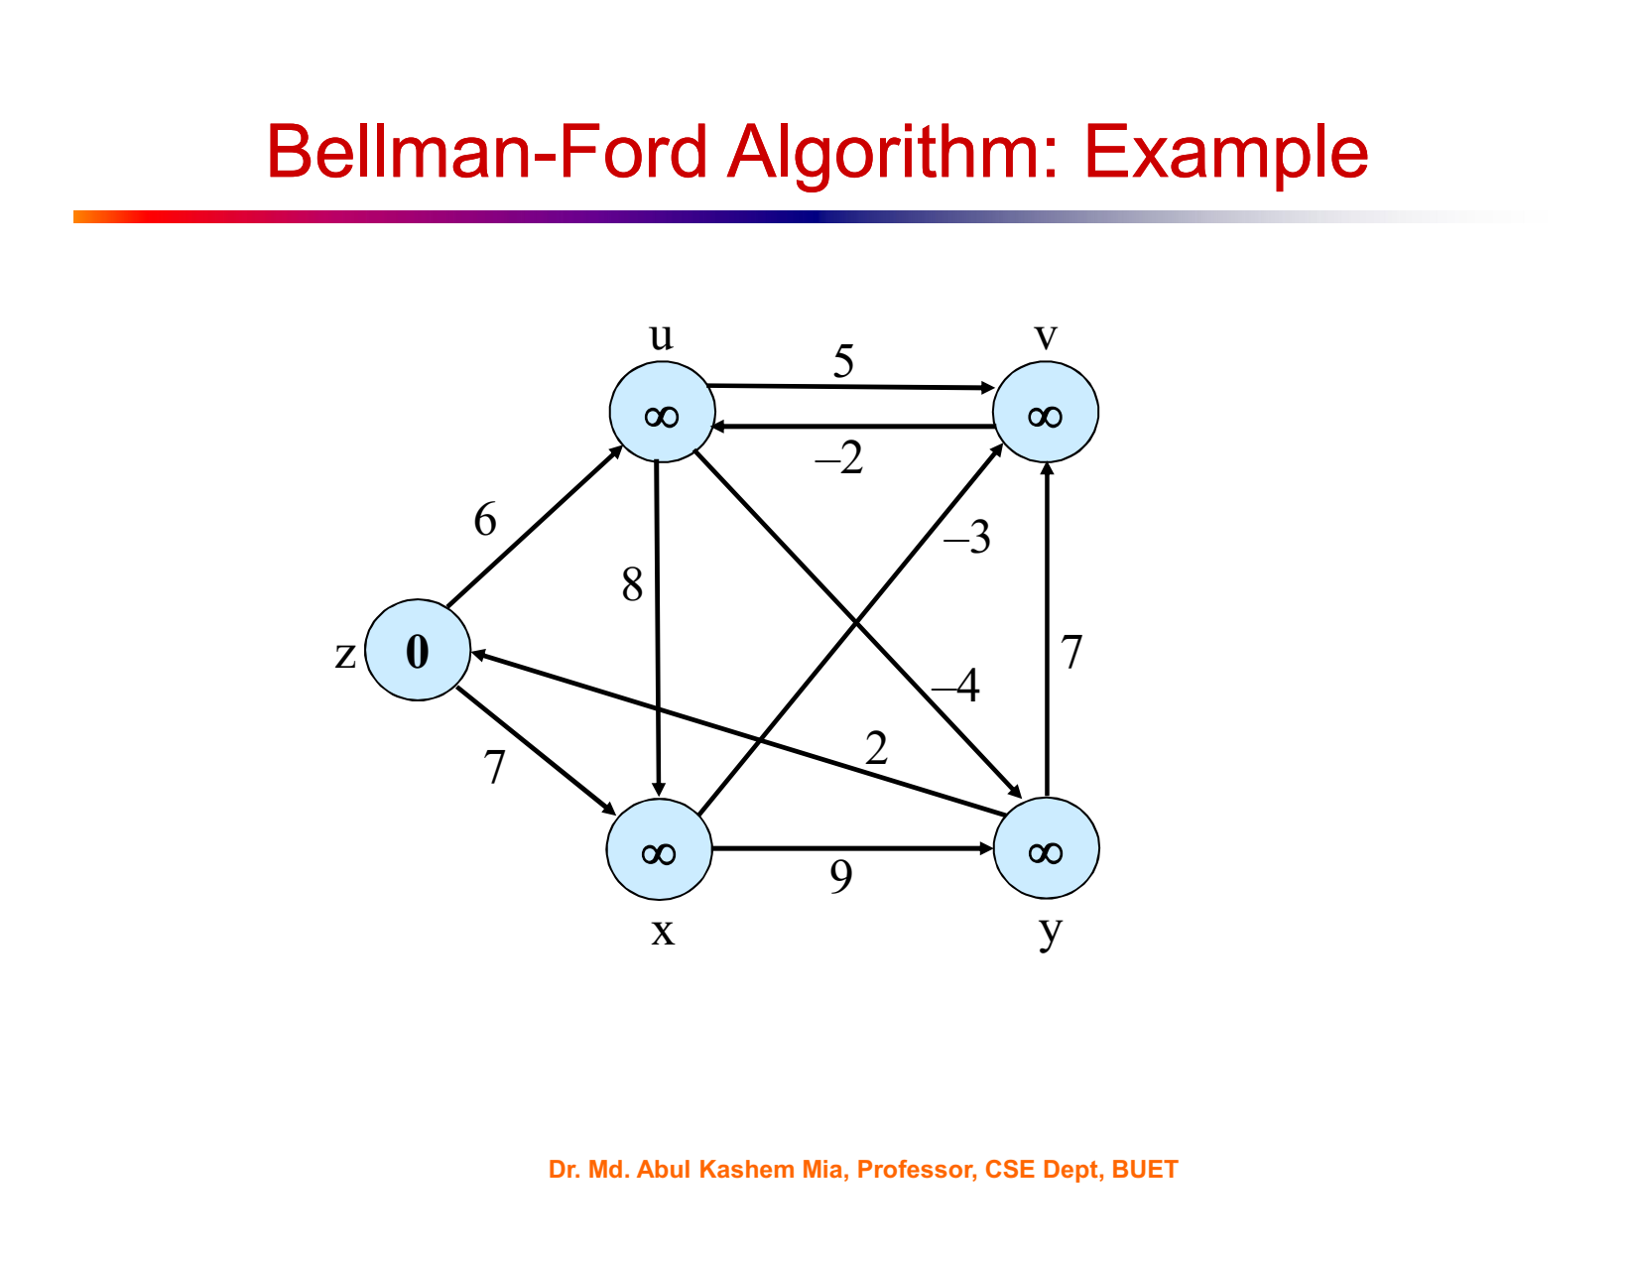
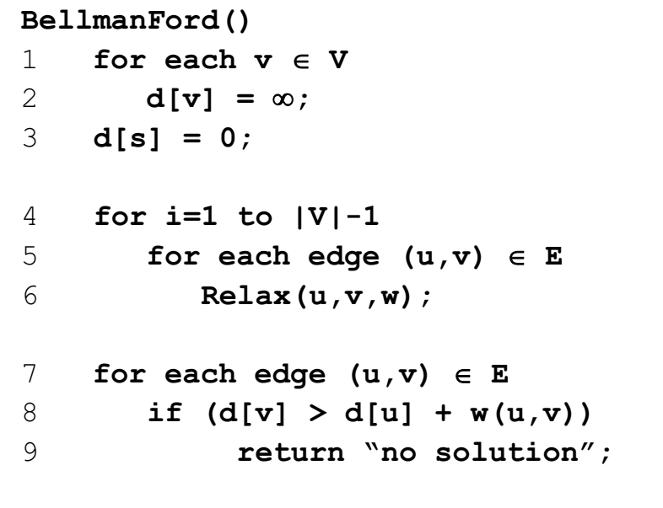

Slide 17
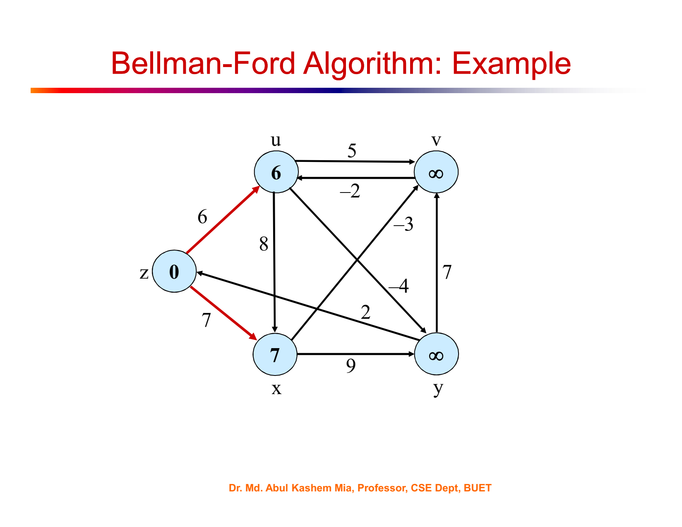

Slide 18
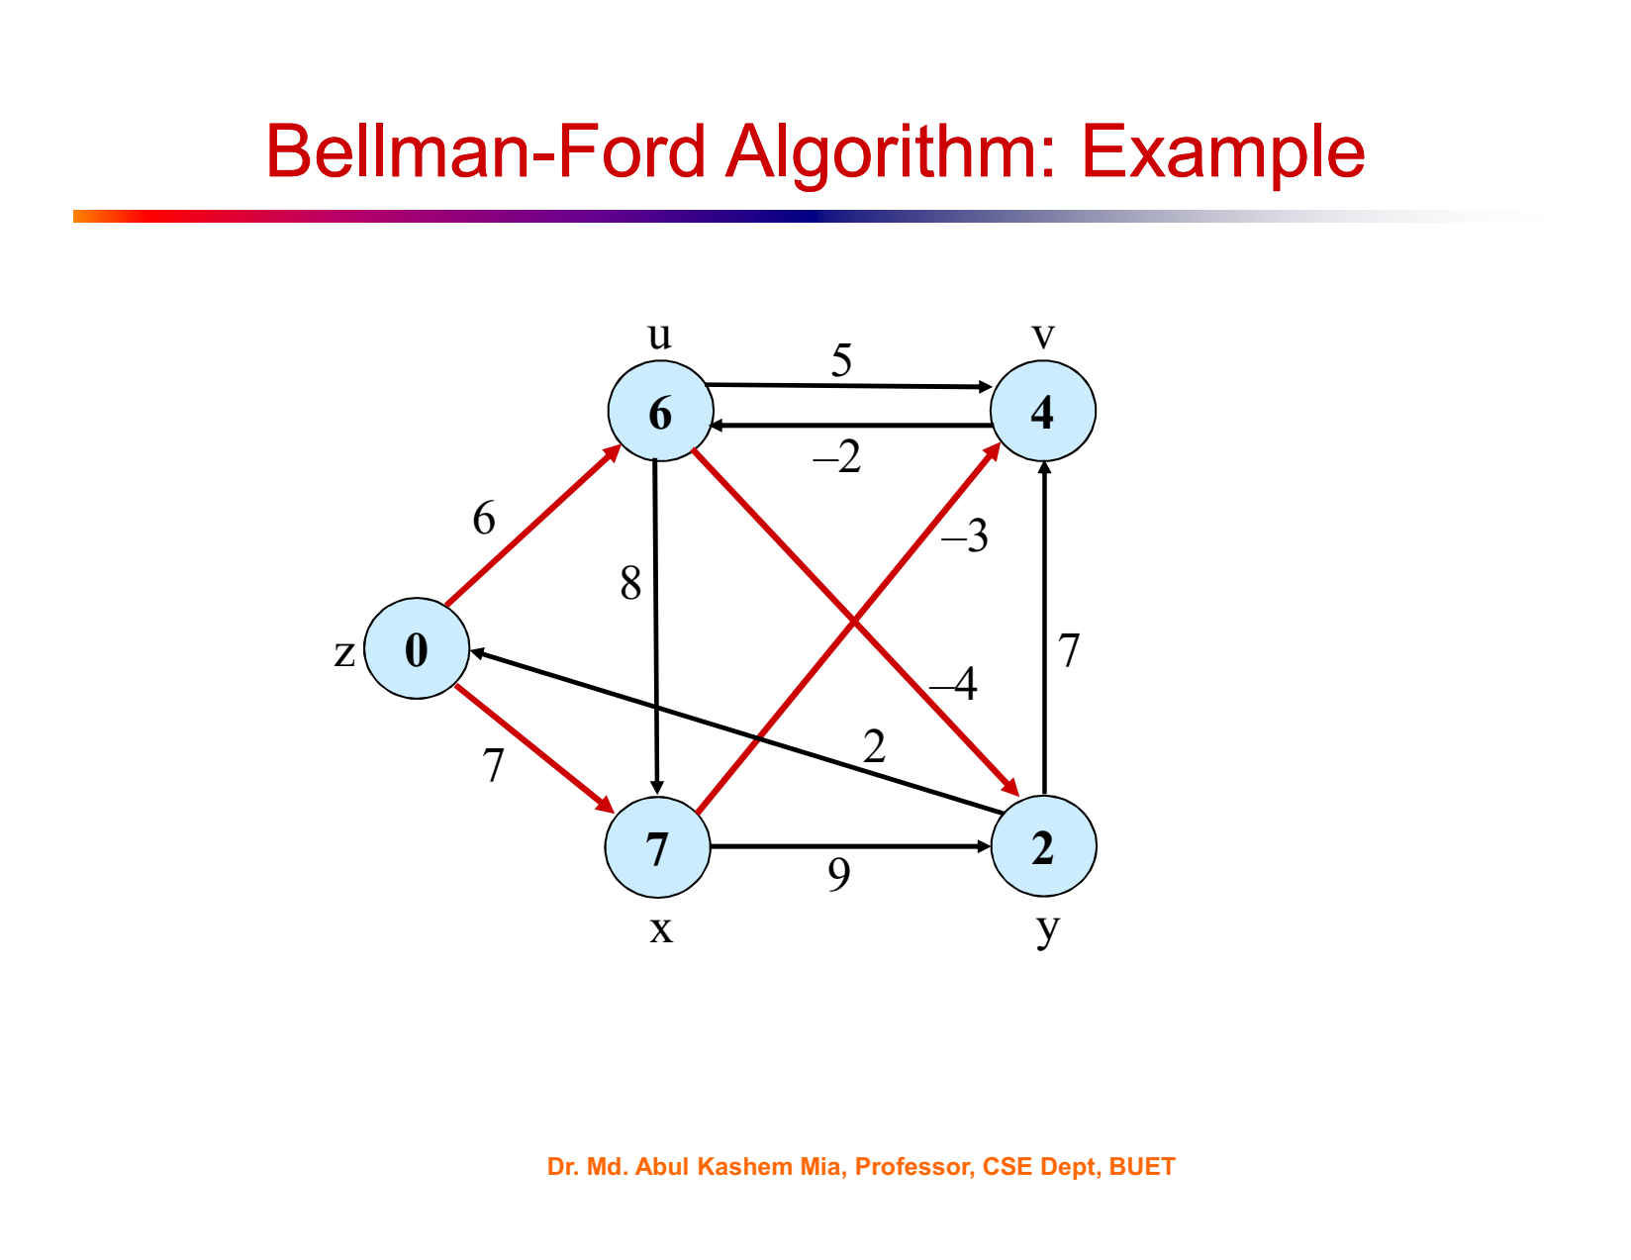

Slide 19
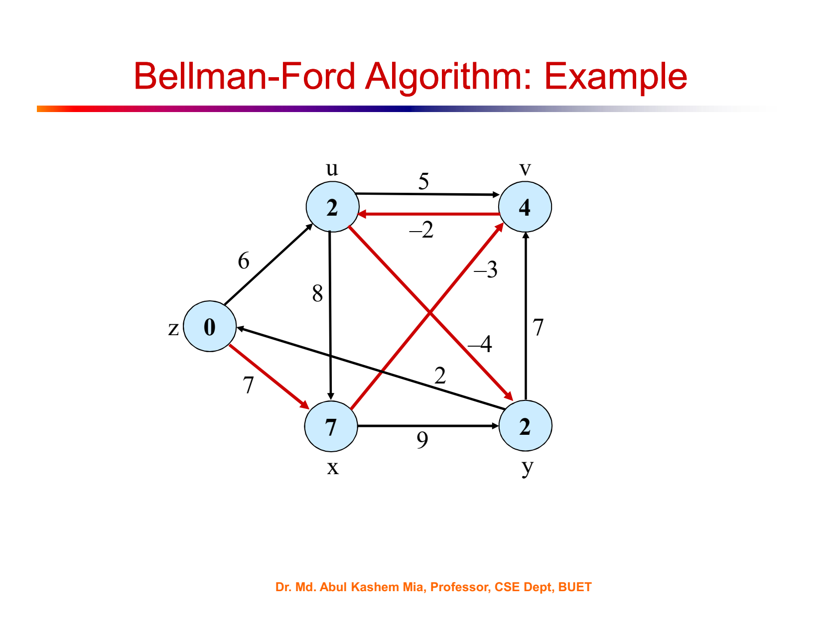

Slide 20


Slide 21
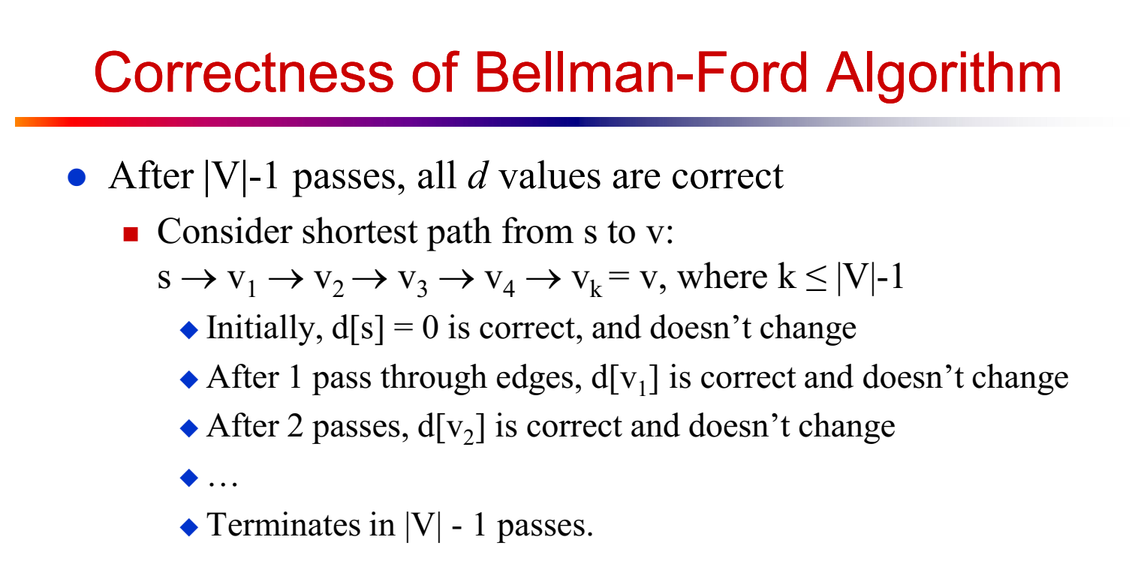

Slide 22
∞
3
∞
-6
2
0
∞
∞
1
3
u
v

Slide 23
1 pass complete out of 4 passes
|v|-1 = 5-1 = 4
∞
3
∞
-6
2
0
1
∞
1
3
u
v

Slide 24
-5
3
∞
-6
2
0
1
∞
1
3
u
v

Slide 25
2 passes complete out of 4 passes
|v|-1 = 5-1 = 4
-5
3
∞
-6
2
0
1
4
1
3
u
v

Slide 26
3 passes complete out of 4 passes
-5
3
-2
-6
2
0
1
4
1
3
u
v

Slide 27
4 passes complete out of 4 passes
-5
3
-2
-6
2
0
0
4
1
3
u
v

Slide 28
-5
3
-2
-6
2
0
0
4
1
3
u
v
0-6=-6 < -5

Slide 29
def bellman_ford(graph, start):
distances = {vertex: float('infinity') for vertex in graph}
distances[start] = 0
for _ in range(len(graph) - 1):
for vertex in graph:
for neighbor, weight in graph[vertex].items():
distance = distances[vertex] + weight
if distance < distances[neighbor]:
distances[neighbor] = distance
# Check for negative weight cycles
for vertex in graph:
for neighbor, weight in graph[vertex].items():
if distances[vertex] + weight < distances[neighbor]:
raise ValueError("Graph contains negative weight cycle")
return distances

Slide 30
Example usage of Bellman-Ford algorithm:
graph = {
'A': {'B': 1, 'C': 4},
'B': {'C': 2, 'D': 5},
'C': {'D': 1},
'D': {'B': -10}
}
start_vertex = 'A'
result = bellman_ford(graph, start_vertex)
print(result)
# Output: {'A': 0, 'B': -9, 'C': -8, 'D': -7}

Slide 31
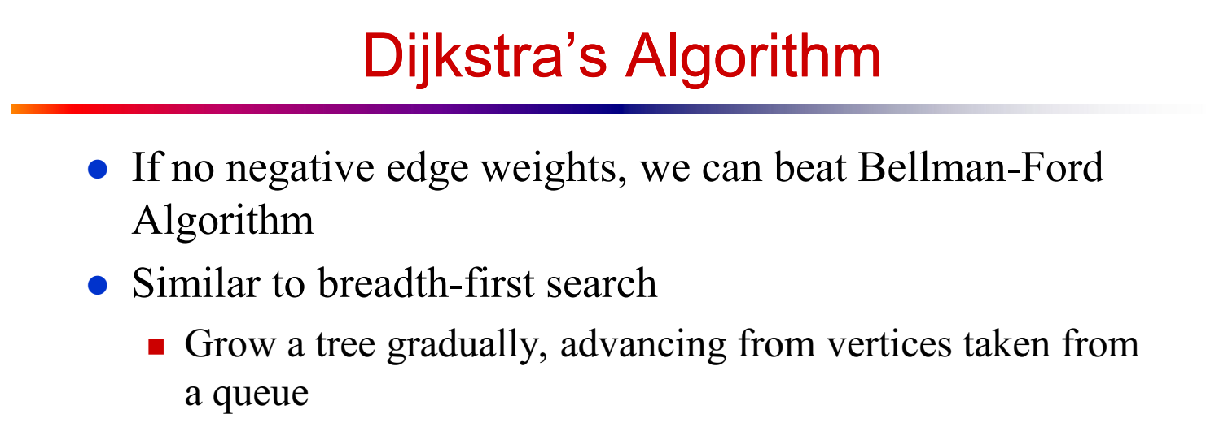

Slide 32
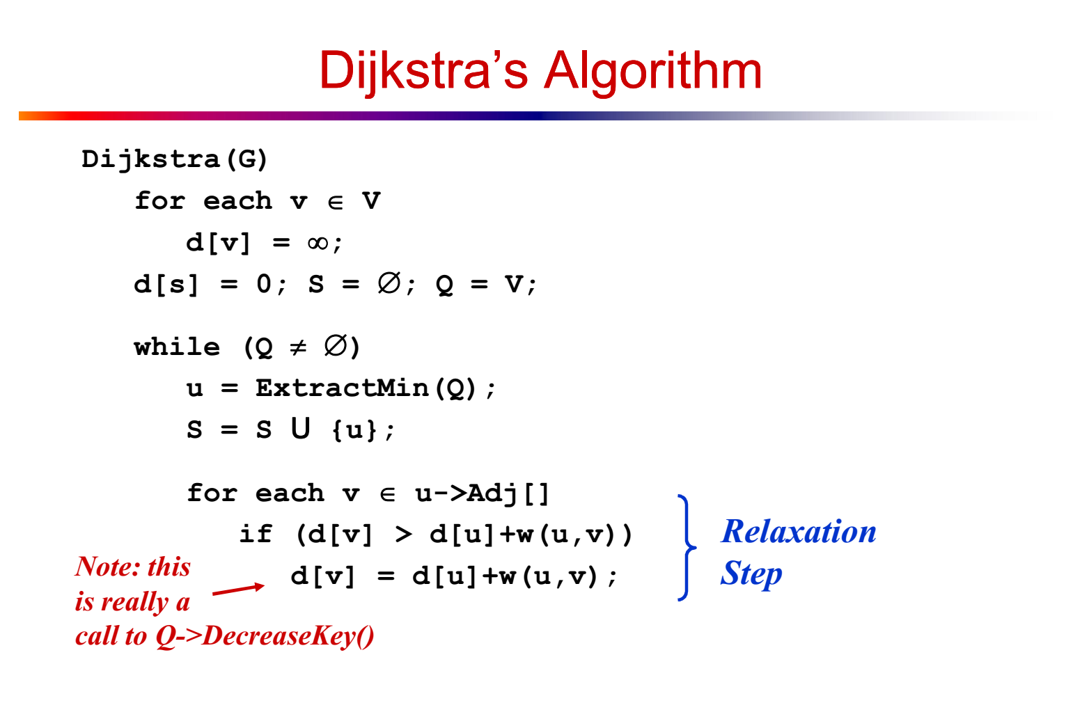
Very similar to BFS
Instead of regular Queue, we use Min Heap

Slide 33
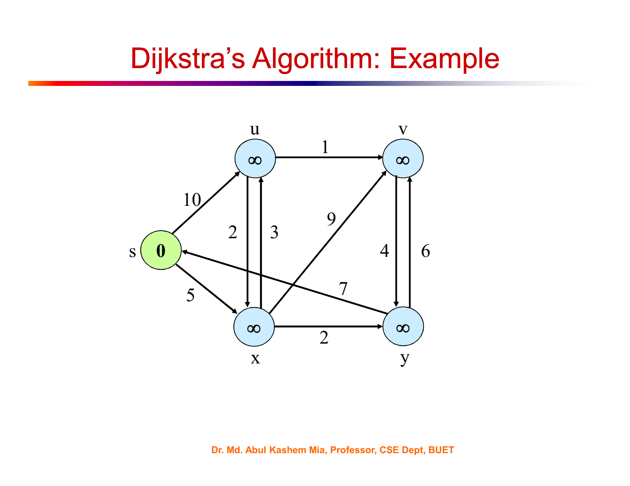
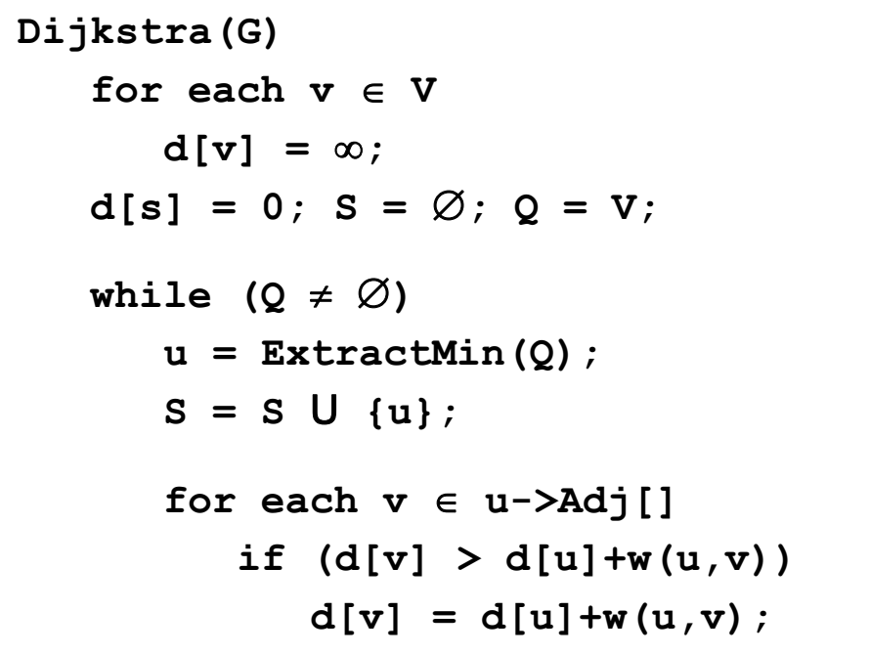

Slide 34
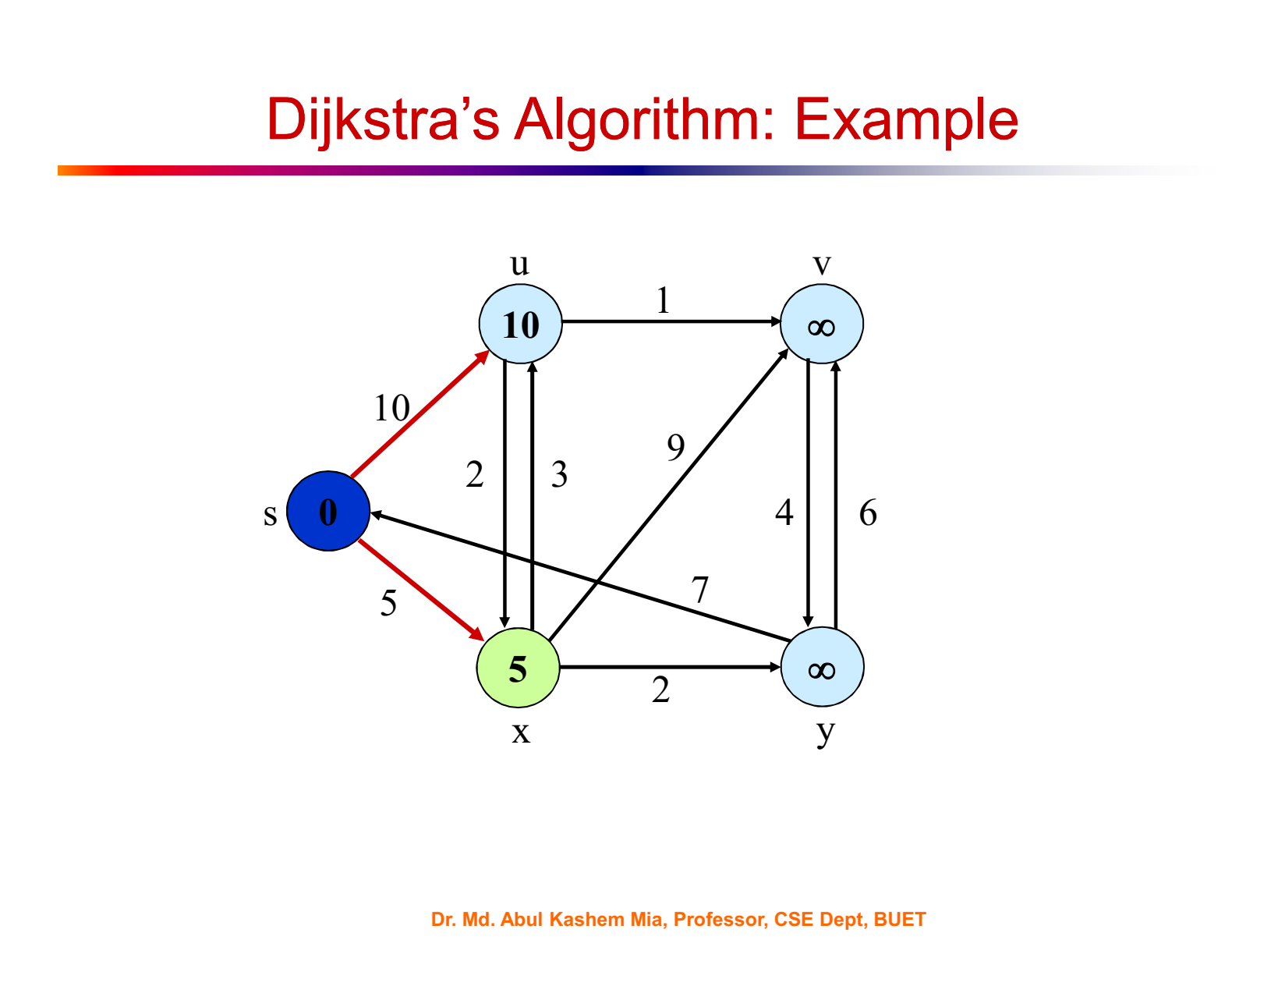

Slide 35
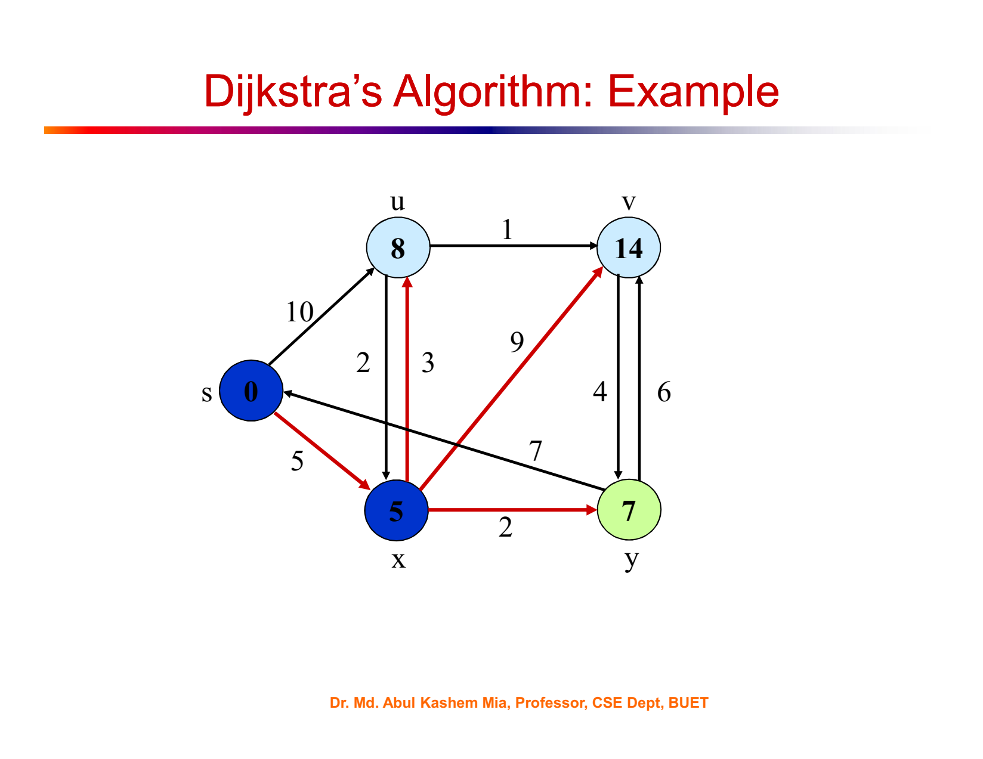

Slide 36
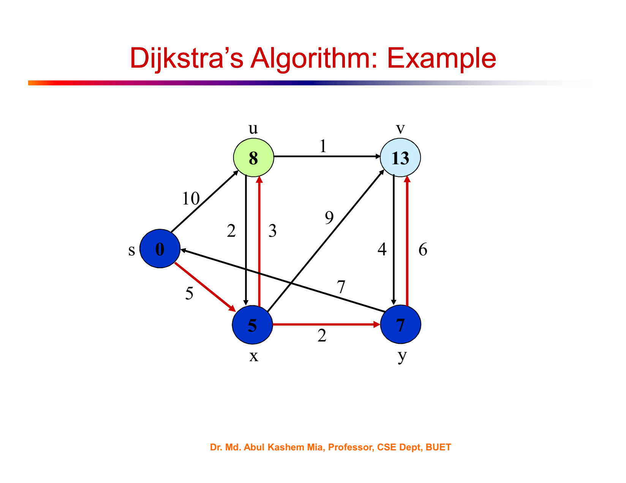

Slide 37
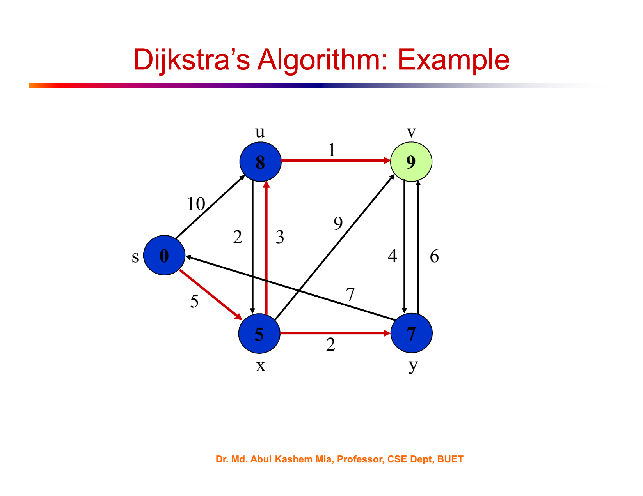

Slide 38
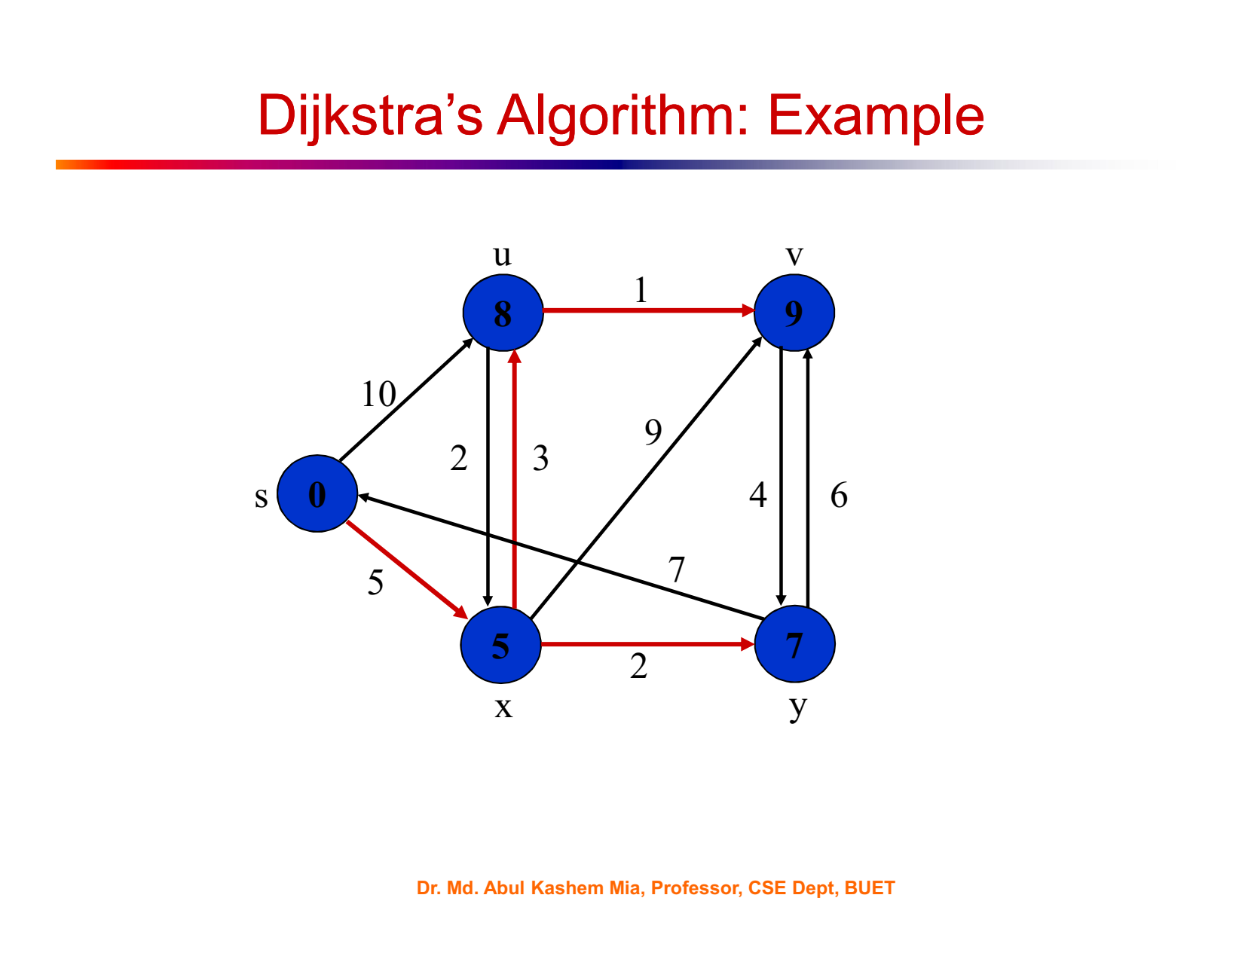

Slide 39
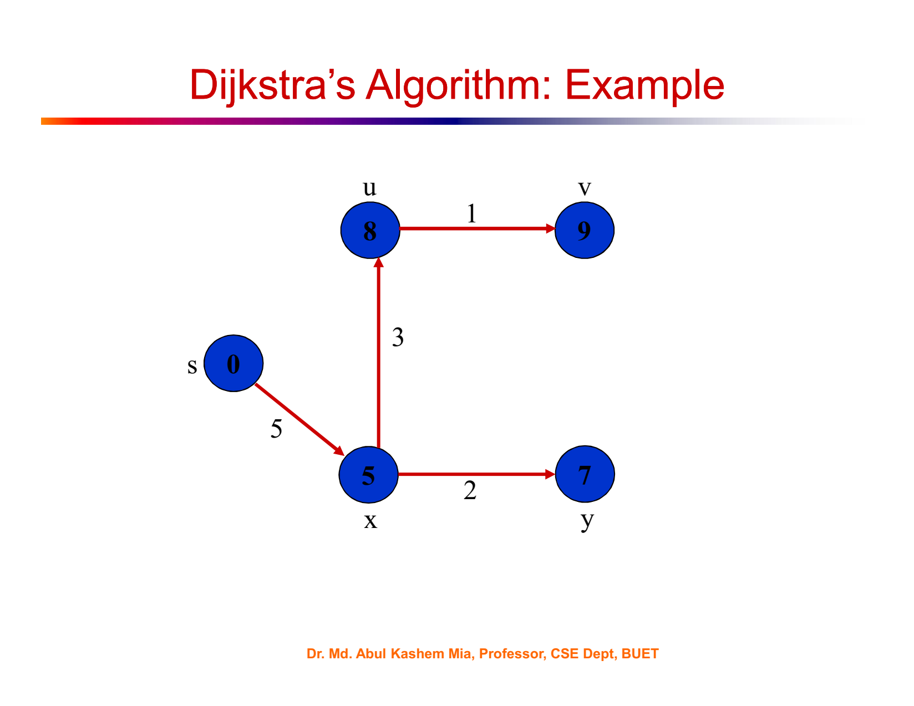

Slide 40
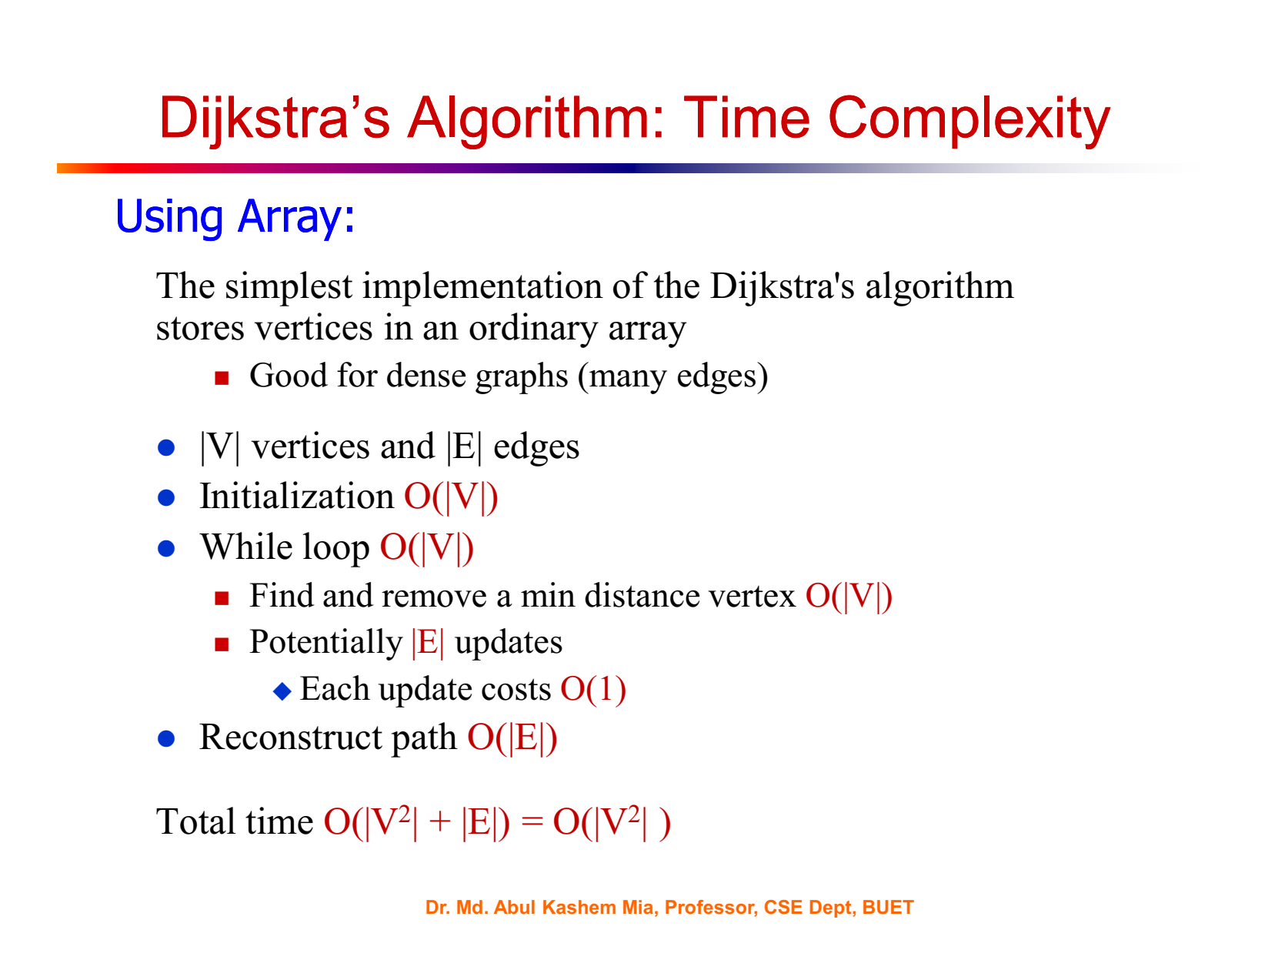

Slide 41
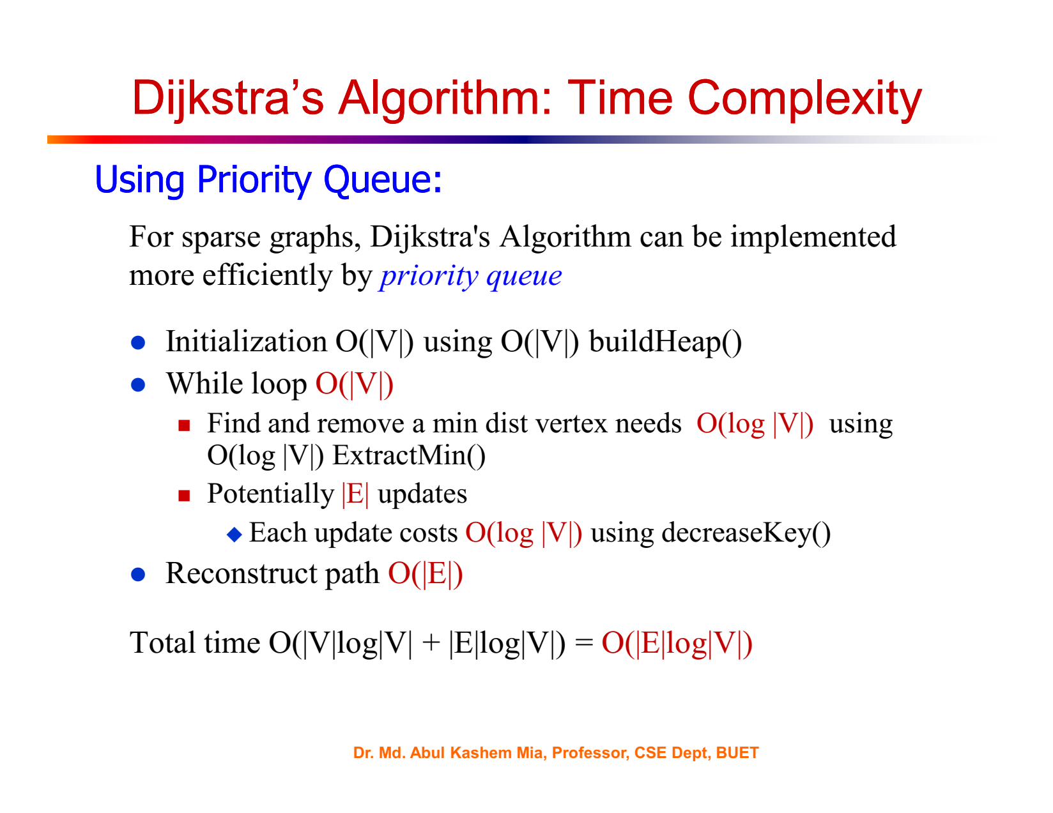

Slide 42
Dijkstra Code
import heapq
def dijkstra(graph, start):
distances = {vertex: float('infinity') for vertex in graph}
distances[start] = 0
priority_queue = [(0, start)]
while priority_queue:
current_distance, current_vertex = heapq.heappop(priority_queue)
if current_distance > distances[current_vertex]:
continue
for neighbor, weight in graph[current_vertex].items():
distance = current_distance + weight
if distance < distances[neighbor]:
distances[neighbor] = distance
heapq.heappush(priority_queue, (distance, neighbor))
return distances

Slide 43
Example usage of Dijkstra's algorithm:
graph = {
'A': {'B': 1, 'C': 4},
'B': {'A': 1, 'C': 2, 'D': 5},
'C': {'A': 4, 'B': 2, 'D': 1},
'D': {'B': 5, 'C': 1}
}
start_vertex = 'A'
result = dijkstra(graph, start_vertex)
print(result)
# Output: {'A': 0, 'B': 1, 'C': 3, 'D': 4}

Slide 44
Resources
3.6 Dijkstra Algorithm - Single Source Shortest Path - Greedy Method - YouTube
4.4 Bellman Ford Algorithm - Single Source Shortest Path - Dynamic Programming - YouTube

